Slide 1
Lets begin

Slide 2
Topic:- Low Cost Solutions for Air Pollution Control
GROUP 7
Aaditya Kumar
Abhinandan Kumar
Akshat Raj
Keshav
Shubham Anand
Kumar Mangalam
Faculty: Shumaila Maam

Slide 3

Low Cost Solutions for Air Pollution Control
Bad air quality affects people all over the world, but fixing it doesn’t have to be expensive. So this presentation looks at affordable and creative ways to reduce air pollution and make the air healthier for everyone.

Slide 4

What is Air Pollution?
Air Pollution refers to the presence of harmful substances in the air that can have many effects on human health, ecosystems, and the environment. These pollutants can be natural, such as wildfires or volcanic ash, but are largely human-made.

Slide 5
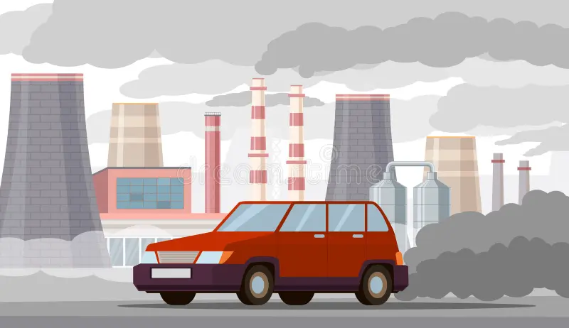

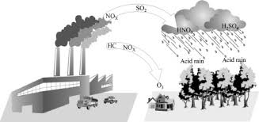
Sources of Air Pollutants
Natural Sources Transportation Industry
Natural Sources
Volcanic Eruptions
Forest Fires
Dust storms
Pollen and Plant Spores

Slide 6

Sources of Air Pollutants
Transportation
Carbon Monoxide (CO)
Nitrogen Oxides (NOₓ)
Particulate Matter (PM)
Carbon Dioxide (CO₂)
Natural Sources
Volcanic Eruptions
Forest Fires
Dust storms
Pollen and Plant Spores
Transportation
Industry

Slide 7
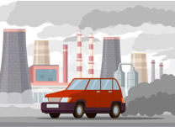
Sources of Air Pollutants
Industry
Sulfur Dioxide (SO₂)
Nitrogen Oxides (NOₓ)
Volatile Organic Compounds (VOCs)
Transportation
Carbon Monoxide (CO)
Nitrogen Oxides (NOₓ)
Particulate Matter (PM)
Carbon Dioxide (CO₂)
Industry
Natural Sources

Slide 8

Sources of Air Pollutants
Industry
Sulfur Dioxide (SO₂)
Nitrogen Oxides (NOₓ)
Volatile Organic Compounds (VOCs)
Natural Sources
Transportation

Slide 9
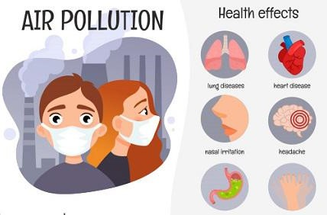
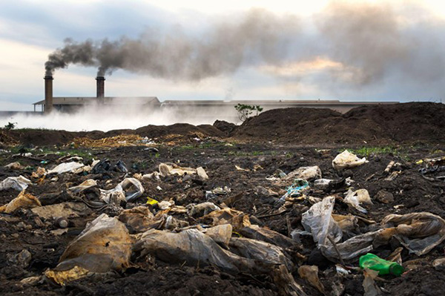
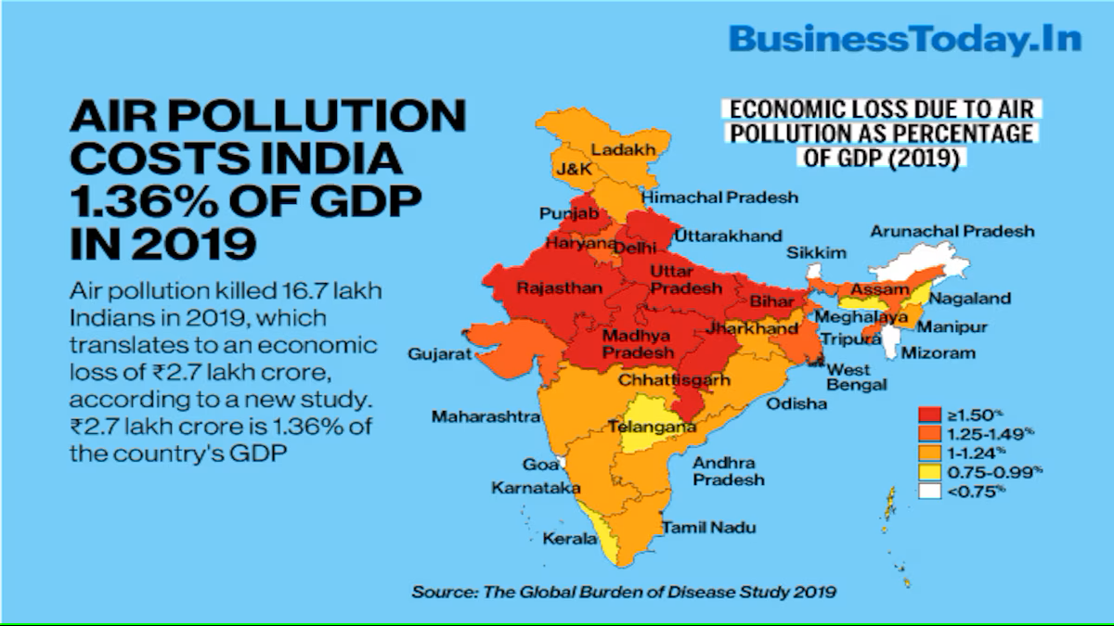
Impacts of Air Pollution
Health Risks Environmental Damage Economic Consequences
Asthma
Increased risk of heart attacks
Lung Cancer
Premature Death
Weakened Immune System
Neurological Effects

Slide 10

Impacts of Air Pollution
Health Risks
Asthma
Increased risk of heart attacks
Lung Cancer
Premature Death
Weakened Immune System
Neurological Effects
Pollutants Involved
Acid Rain Formation
Impact on Forests
Long-Term Effects

Slide 11

Impacts of Air Pollution
Environmental Damage
Pollutants Involved
Acid Rain Formation
Impact on Forests
Long-Term Effects
Healthcare Costs
Agricultural Losses
Damage to Infrastructure
Tourism Decline
Reduced Property Values

Slide 12
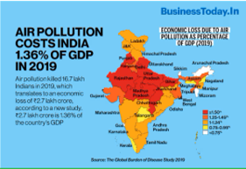
Impacts of Air Pollution
Economic Consequences
Healthcare Costs
Agricultural Losses
Damage to Infrastructure
Tourism Decline
Reduced Property Values

Slide 13
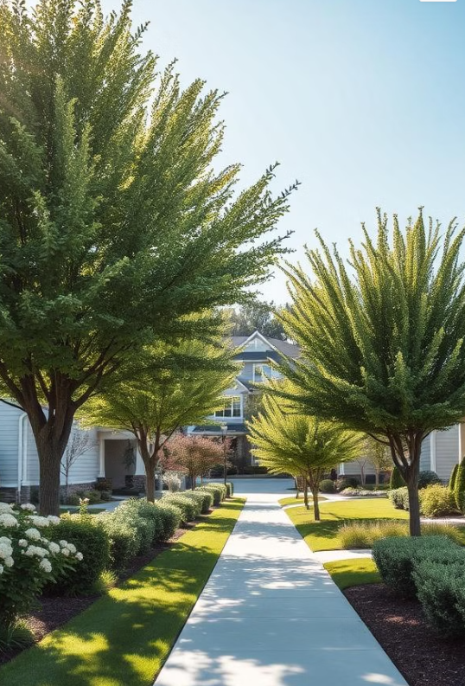
some affordable
products
that can help
control
air pollution

Slide 14
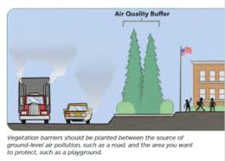
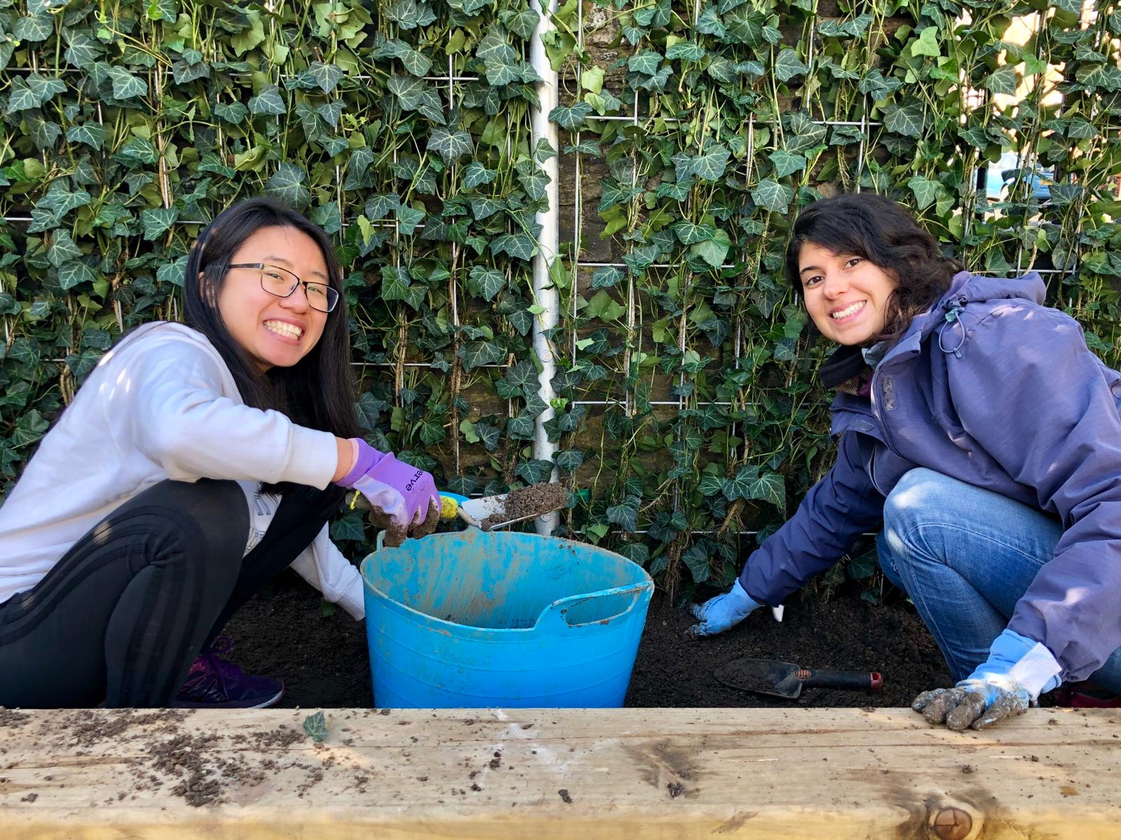
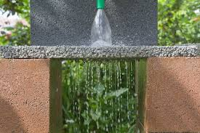
Passive Filtration Systems: An Affordable Option
Vegetation Barriers help reduce air pollution by using plants to filter, absorb, and trap pollutants from the air.
Here’s how they work:
Trapping Particulate Matter (PM)
Absorbing Pollutant Gases : (CO₂), nitrogen dioxide (NO₂), and sulfur dioxide (SO₂) through their leaves during photosynthesi
Vegetation Barriers
Permeable Pavements

Slide 15
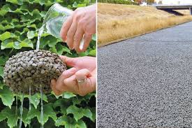
Passive Filtration Systems: An Affordable Option
Permeable Pavements are specially designed pavements that allow water to pass through them, rather than causing runoff
Vegetation Barriers help reduce air pollution by using plants to filter, absorb, and trap pollutants from the air.
Permeable Pavements
Here’s how they contribute to reducing air pollution:
Dust Reduction
Temperature Control
Stormwater Filtration
Plant-Friendly
Here’s how they work:
1} Trapping Particulate Matter (PM)
2} Absorbing Pollutant Gases
3} Cooling Effect
4} Noise Reduction

Slide 16

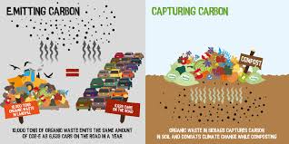
Passive Filtration Systems: An Affordable Option
Permeable Pavements are specially designed pavements that allow water to pass through them, rather than causing runoff
Vegetation Barriers
Here’s how they contribute to reducing air pollution:
1} Dust Reduction
2} Temperature Control
3} Stormwater Filtration
4} Plant-Friendly

Slide 17


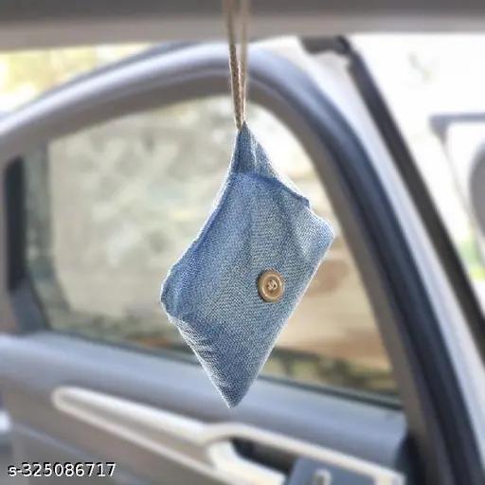
Waste Management to Reduce Air Pollution
Low-cost composting techniques to prevent landfill emissions
Community recycling initiatives to reduce waste burning
DIY methods to upcycle waste into useful products

Slide 18
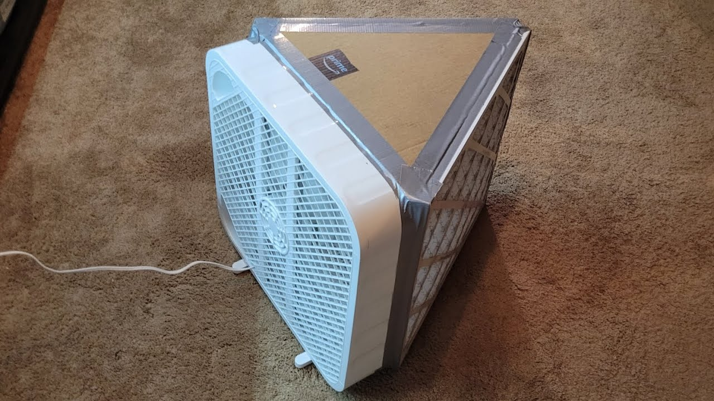
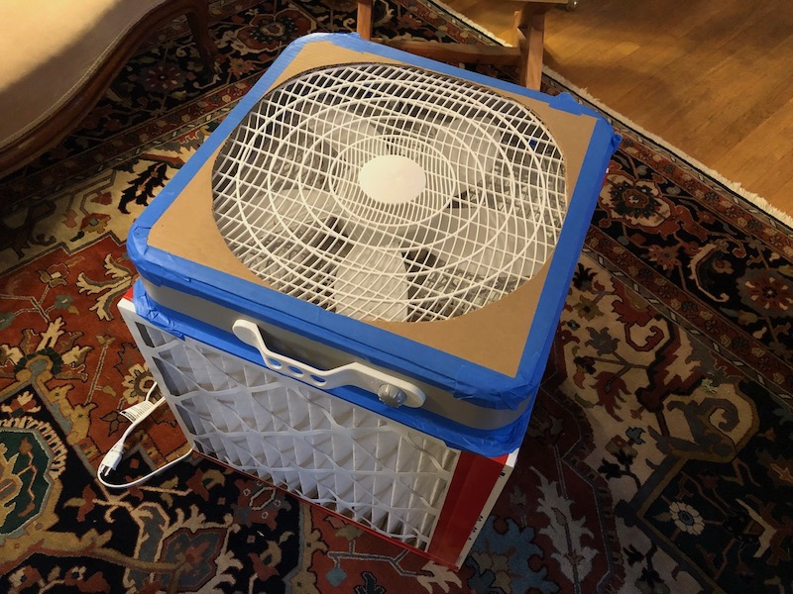
Bamboo Charcoal Bags
Activated carbon filters can trap pollutants, odors, and harmful gases.
Available as standalone purifiers or as add-ons for existing systems, they're effective and affordable for small spaces.

Slide 19
DIY Air Filter Box Fans
Box fans with HEPA filters attached are inexpensive DIY air purifiers for indoor air.
These reduce indoor pollutants effectively, especially during events like wildfires.

Slide 20

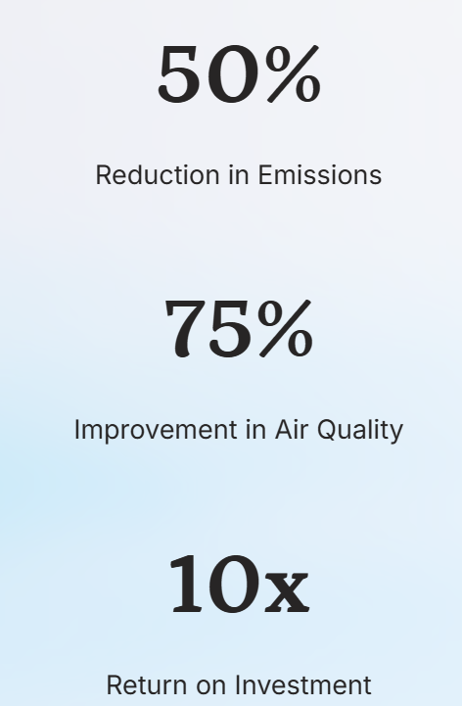
Conclusion : A Sustainable Future with Clean Air
By embracing low-cost, innovative solutions, we can reduce air pollution and create a healthier, more sustainable future for all. This presentation has outlined a roadmap to achieve these goals through a combination of ways which is cost efficient and can secure our future.

Slide 21
Everyone has a role—individuals, businesses, and governments must work together to reduce pollution.
A cleaner environment supports better health, a resilient ecosystem, and a livable planet for future generations.
Clean air is not just a goal—it is a necessity for a sustainable future.

Slide 22


